Slide 1

Missile Interception with Reachability Tools
Thesis Preparation
António Canteiro
70674 – Graduate degree in Computer and Electrotechnical Engineering
Adviser: Daniel Silvestre

Slide 2

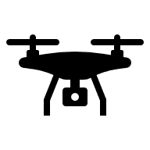

Introduction
Missile defense in urban areas is challenging.
Quad-rotor UAVs are widely deployable and versatile.
Much work has been done to turn them into defense platforms.
However, there is a need for a quad-rotor flight controller that incorporates reachability analysis.

Slide 3
State of the Art
Intercept type quad-rotor controllers
Most solutions are optimal control-based (LQR, NMPC, CBF-CLF).
Provides the best result according to the cost function used and are robust to perturbations.
Cannot guarantee trajectory feasibility on their own.
There is a gap in research of Reachability-based interception controllers, which can provide safety guarantees.

Slide 4



Problem Formulation
Two player defense-intercept game
Missile Objective Hierarchy:
Static target interception.
Dynamic pursuer evasion.
$${\vec{r}}_{R}\left(k\right)$$
C
$${\vec{d}}_{RC}\left(k\right)$$
R
Drone Objective Hierarchy:
Dynamic target interception.
Static area defense.
$${\vec{d}}_{DR}\left(k\right)$$
D

Slide 5



Problem Formulation
Two player defense-intercept game
$${\vec{r}}_{R}\left(k+1\right)$$
Missile Objective Hierarchy:
Static target interception.
Dynamic pursuer evasion.
$${\vec{d}}_{RC}\left(k+1\right)$$
C
R
$${\vec{d}}_{DR}\left(k+1\right)$$
Drone Objective Hierarchy:
Dynamic target interception.
Static area defense.
D

Slide 6
Proposed Solution
Reachability-based Approach
D
R
Reachable space of drone
Reachable space of missile
Critical area
Safety Shadow
C

Slide 7
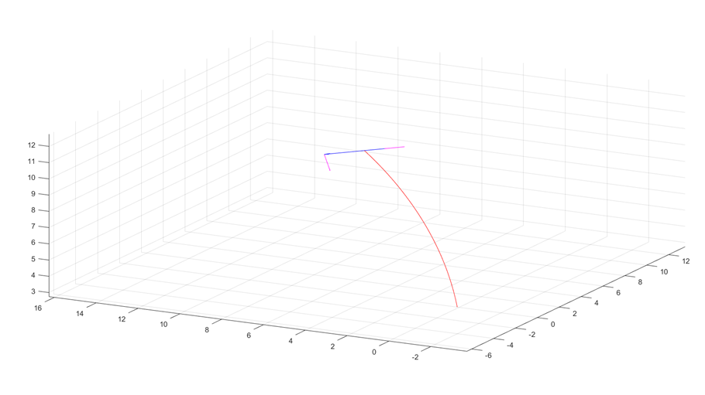
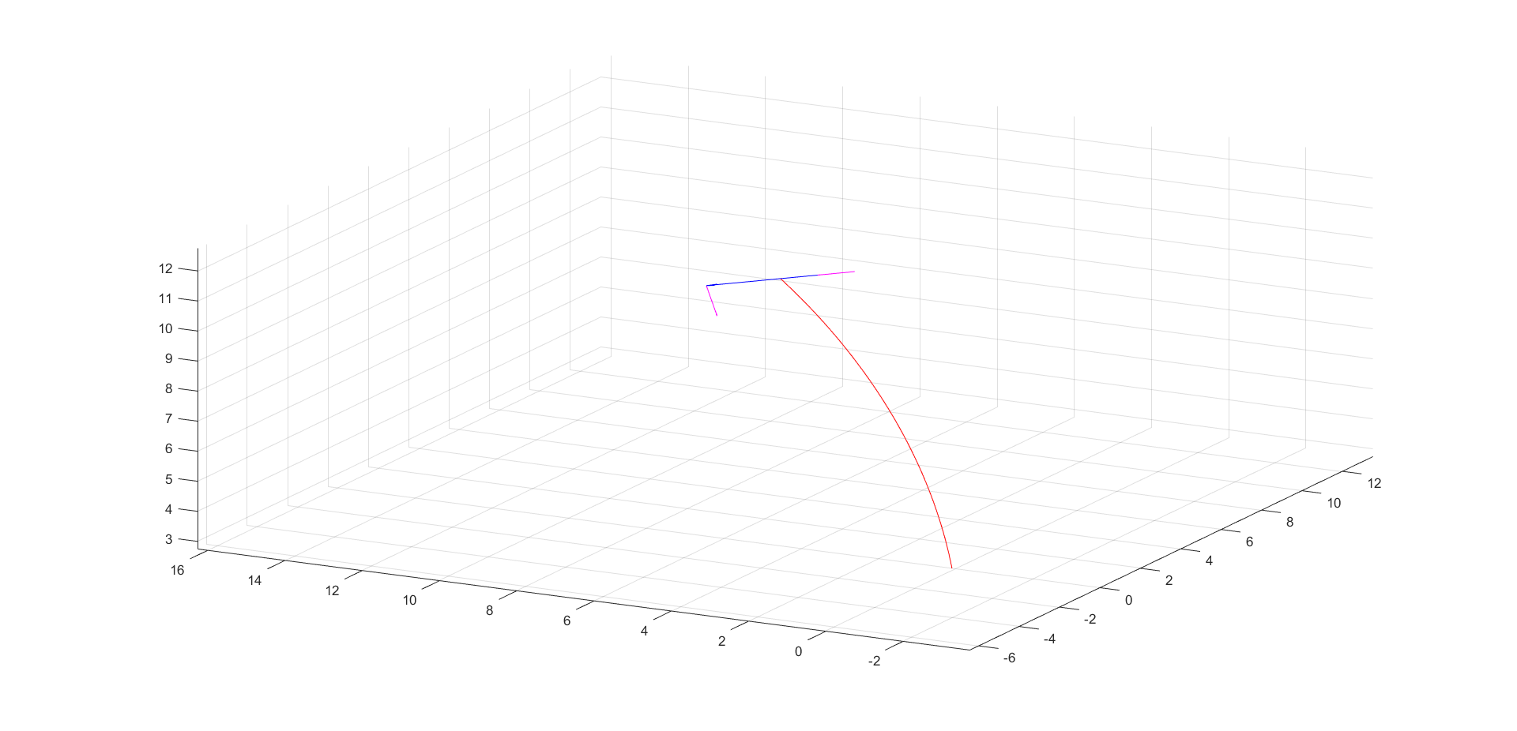
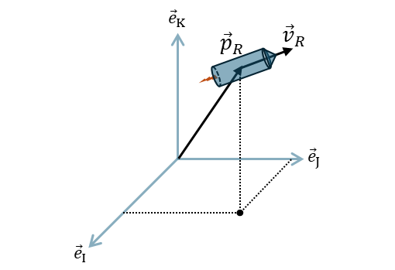
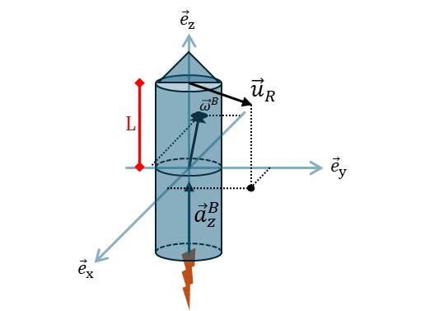
Prior Work
Missile model simulation
MATLAB Simulation
Simulation Parameters:
Open loop, to validate model behavior.
Constant input.
Initial conditions:
Angular and linear velocity are zero.
Thruster position at origin.
Missile is upright.
Diagram of state variables

Slide 8
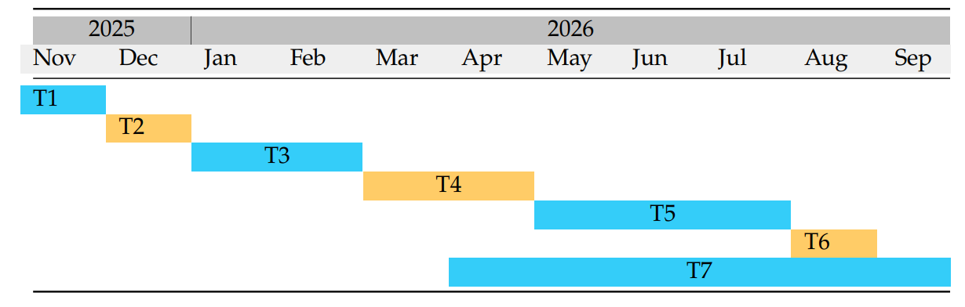
Schedule
Literature Review
Definition of Requirements
Open-Loop Design
Defense-Intercept Algorithm Definition
Controller Validation in Simulation
Test Flight Validation
Writing Thesis

Slide 9
Thank you

